Slide 1
PICNIC
Input Data
3
2 1
0 1
4 6
0 1 1 2 2 3 3 0 0 2 1 3
6 10
0 1 0 2 1 2 1 3 1 4 2 3 2 4 3 4 3 5 4 5
Input Data
1
3
4

Slide 2
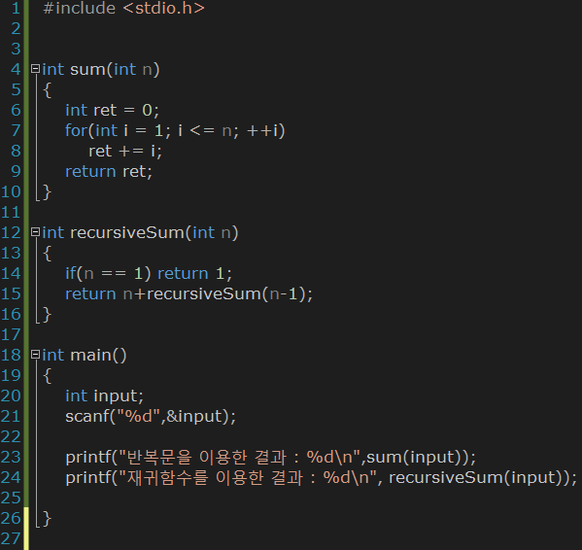

Slide 3
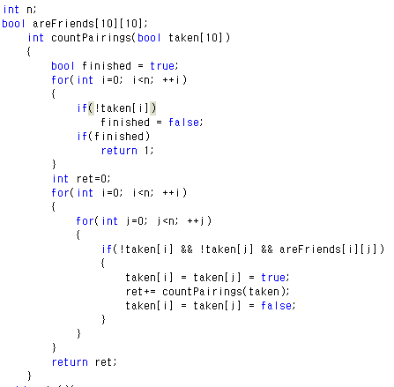
(0, 1),(1, 0),(4, 6),(6, 4)

Slide 4
